Slide 1
Optimization for ML (4)
CS771: Introduction to Machine Learning
Piyush Rai

Slide 2
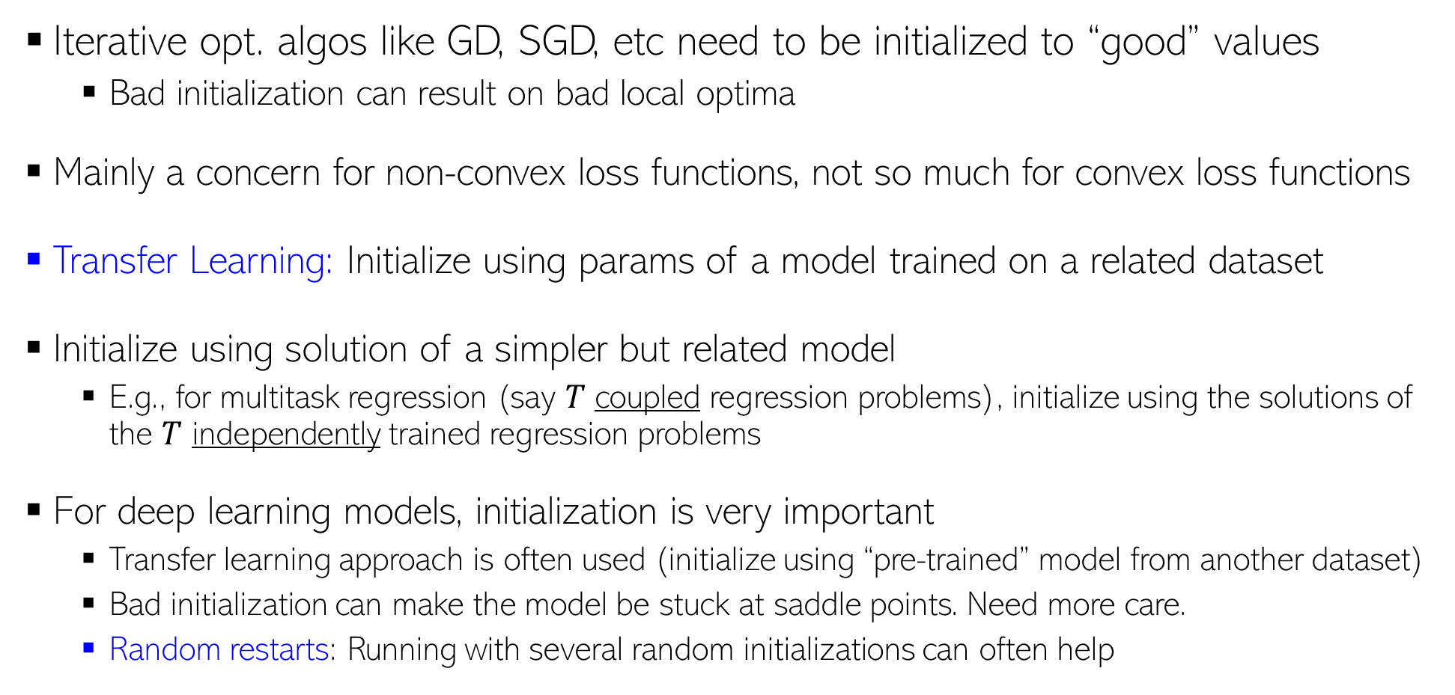
Some Practical Aspects: Initialization
Iterative opt. algos like GD, SGD, etc need to be initialized to “good” values
Bad initialization can result on bad local optima
Mainly a concern for non-convex loss functions, not so much for convex loss functions
Transfer Learning: Initialize using params of a model trained on a related dataset
Initialize using solution of a simpler but related model
E.g., for multitask regression (say $T$ coupled regression problems), initialize using the solutions of the $T$ independently trained regression problems
For deep learning models, initialization is very important
Transfer learning approach is often used (initialize using “pre-trained” model from another dataset)
Bad initialization can make the model be stuck at saddle points. Need more care.
Random restarts: Running with several random initializations can often help
But still be careful with learning rate
If the goal is to learn the same model but for a different training set

Slide 3

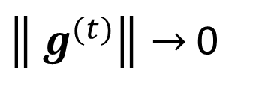



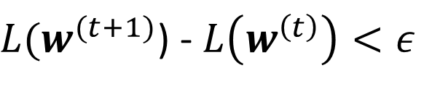
Some Practical Aspects: Assessing Convergence
Various ways to assess convergence, e.g. consider converged if
The objective’s value (on train set) ceases to change much across iterations
The parameter values cease to change much across iterations
Above condition is also equivalent to saying that the gradients are close to zero
The objective’s value has become small enough that we are happy with ☺
Use a validation set to assess if the model’s performance is acceptable (early stopping)
$L(w^{(t+1)}$) - $L\left(w^{\left(t\right)}\right)<ε$
(for some small pre-defined $ε$)
$\left\|{ w}^{(t+1)} −{ w}^{(t)}\right\|<τ$
(for some small pre-defined $τ$)
$\left\|{ g}^{(t)}\right\|→$0
Caution: May not yet be at the optima. Use at your own risk!

Slide 4
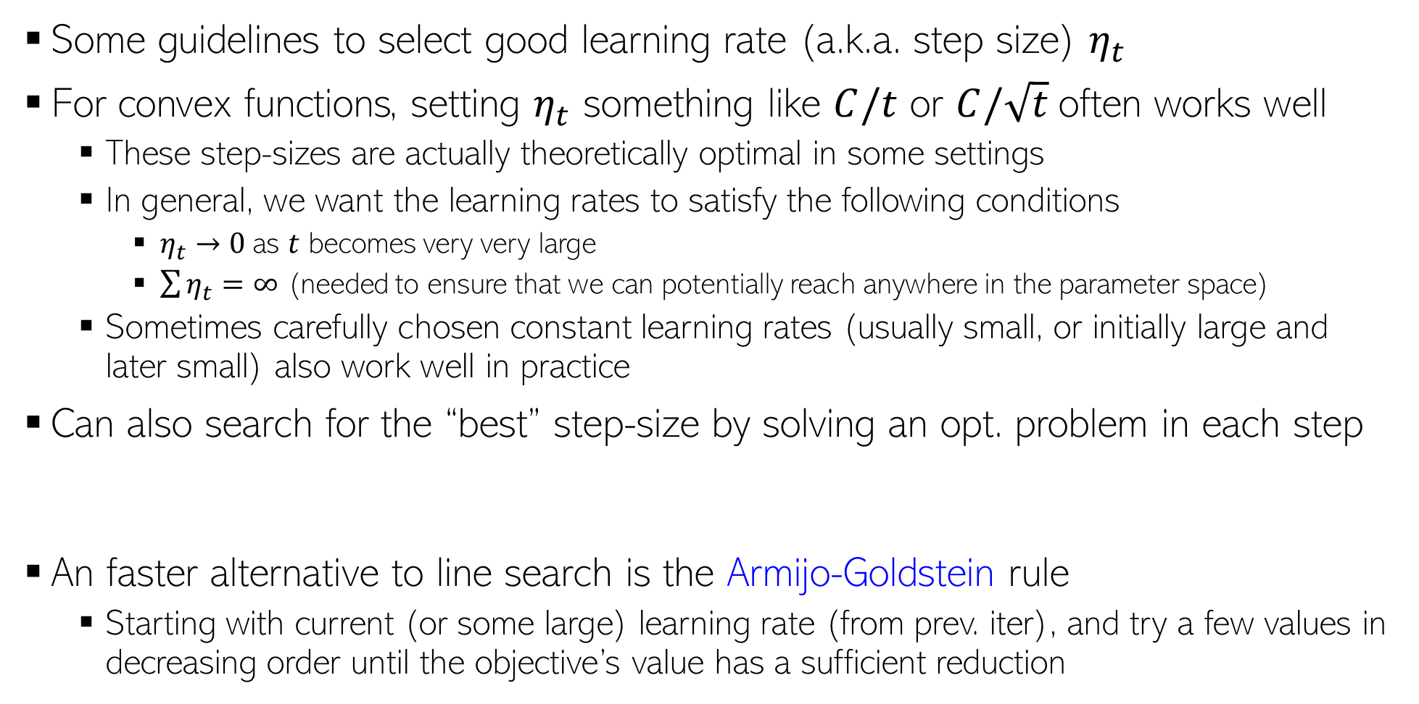
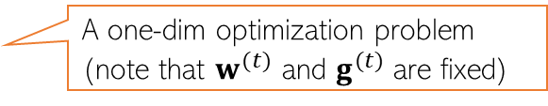
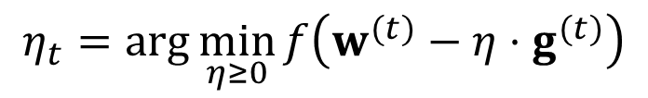
Some Practical Aspects: Learning Rate (Step Size)
Some guidelines to select good learning rate (a.k.a. step size) $η_{t}$
For convex functions, setting $η_{t}$ something like $C/t$ or $C/\sqrt{t}$often works well
These step-sizes are actually theoretically optimal in some settings
In general, we want the learning rates to satisfy the following conditions
$η_{t}→0$as $t$ becomes very very large
$\sum{η_{t}}=∞$ (needed to ensure that we can potentially reach anywhere in the parameter space)
Sometimes carefully chosen constant learning rates (usually small, or initially large and later small) also work well in practice
Can also search for the “best” step-size by solving an opt. problem in each step
An faster alternative to line search is the Armijo-Goldstein rule
Starting with current (or some large) learning rate (from prev. iter), and try a few values in decreasing order until the objective’s value has a sufficient reduction
C is a hyperparameter
Also called “line search”
$$η_{t}=\arg{\min_{η≥0}{f\left(w^{(t)}−η⋅g^{(t)}\right)}}$$
A one-dim optimization problem (note that $w^{(t)}$ and $g^{(t)}$ are fixed)

Slide 5
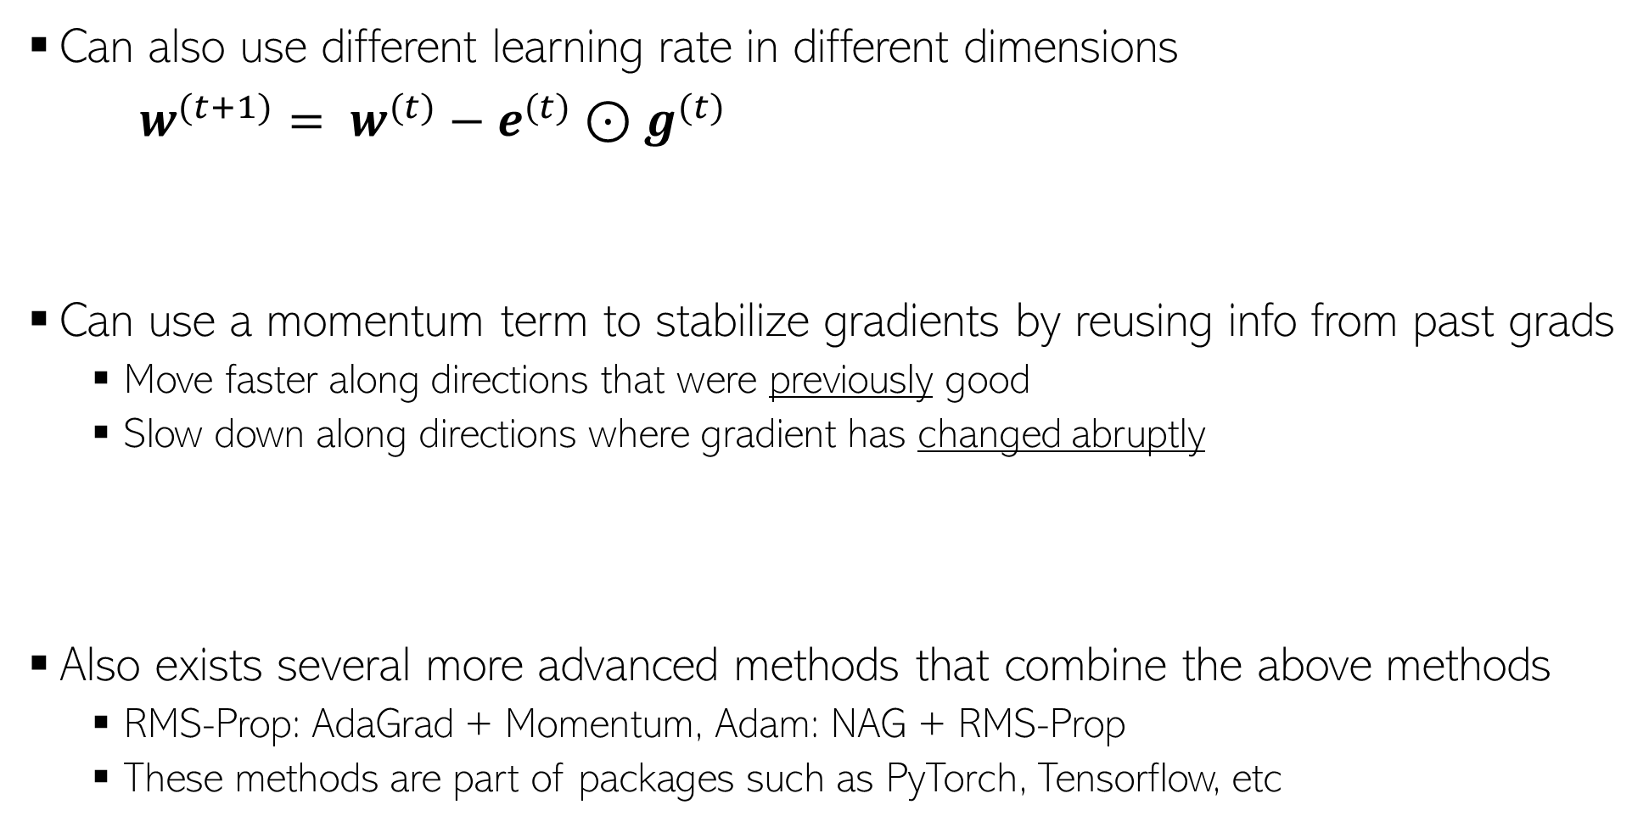
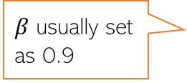


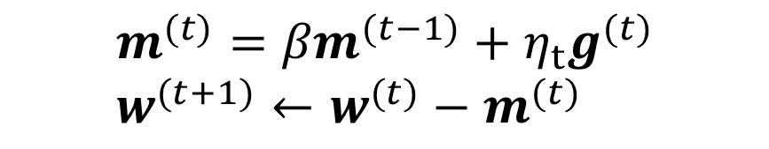
Some Practical Aspects: Adaptive Gradient Methods
If some dimension had big updates recently (marked by large gradient values), show down along those directions by using smaller learning rates - AdaGrad
(Duchi et al, 2011)
Can also use different learning rate in different dimensions
$w^{(t+1)}= w^{(t)}−e^{(t)}{⊙g}^{(t)}$
Can use a momentum term to stabilize gradients by reusing info from past grads
Move faster along directions that were previously good
Slow down along directions where gradient has changed abruptly
Also exists several more advanced methods that combine the above methods
RMS-Prop: AdaGrad + Momentum, Adam: NAG + RMS-Prop
These methods are part of packages such as PyTorch, Tensorflow, etc
$$e_{d}^{(t)}= \frac{1}{\sqrt{ε+\sum_{τ=1}^{t}{{\left(g_{d}^{(t)}\right)}^{2}}}}$$
Vector of learning rates along each dimension
Element-wise product of two vectors
In an even faster version of this, $g^{(t)}$ is replaced by the gradient computed at the next step if previous direction were used, i.e., $∇L(w^{\left(t\right)}−{βm}^{(t−1)}$).
Called Nesterov’s Accelerated Gradient (NAG) method
The “momentum” term. Set to 0 at initialization
$$m^{(t)}={βm}^{(t−1)}+η_{t}g^{(t)} \\ w^{(t+1)}←w^{(t)}−m^{(t)}$$
$β$ usually set as 0.9

Slide 6
Optimization for ML: Some Final Comments
Gradient methods are simple to understand and implement
More sophisticated optimization methods also often use gradient methods
Backpropagation algo used in deep neural nets is GD + chain rule of differentiation
Use subgradient methods if function not differentiable
Constrained optimization can use Lagrangian or projected/proximal GD
Second order methods such as Newton’s method faster but computationally expensive
But computing all this gradient related stuff by hand looks scary to me. Any help?
Don’t worry. Automatic Differentiation (AD) methods available now (will see them later)
AD only requires specifying the loss function (especially useful for deep neural nets)
Many packages such as Tensorflow, PyTorch, etc. provide AD support
But having a good understanding of optimization is still helpful

